Slide 1


DESIGNING & DEVELOPING A
CENTRALIZED LOAN APPLICATION
MANAGEMENT SYSTEM
NAME : KATONGO BUPE
STUDENT ID : 2010100
PROGRAMME : BIT (INFORMATION TECHNOLOGY)
SUPERVISOR : MR. SILWIZYA C.

Slide 2
TABLE OF CONTENT
Introduction and Background
Statement of the Problem
Research Objectives
Research Questions
Scope of Research
Significance of the Study
Literature Review
Theoretical / Conceptual framework
Research Methodology
Findings (Data Presentation, Analysis, & Discussions)
Conclusion
Recommendations

Slide 3
Introduction and Background
The concept of "microfinance" refers to the lending of small sums of money to underprivileged businesspeople and ordinary people.
Microfinance has many advantages for developing countries like Zambia. This particular type of lending has been around for a while. In Africa and other developing nations, Microfinance institutions (MFIs) are now the primary source of funding for microbusinesses, this therefore provides a sustainable access to microfinance.
In the modern day and age, internet has become essential to everyone. This project focuses on the creation of a mobile application and web app that seamlessly mitigates the problems to be discussed in the next slide.

Slide 4
Statement of the Problem
The Inflexibility of comparing interest rates and services between different microfinance Institutions becomes a challenge, A client/debtor has to look up every microfinance company on the internet, this is time consuming and inefficient.
Most microfinance institutions use traditional ways to handle loan application and client/debtor credentials. A client/debtor has to submit hard copies of NRC and other required documents to a microfinance institution for a Loan application to be processed.
Tracking loans as well as handling loan defaults is a massive challenge most microfinance institutions face.

Slide 5
Research Objectives
To develop a centralized loan application management system that shall allow borrowers to compare interest rates between different microfinance institutions.
To implement a cross platform mobile app that shall Digitize the Loan Application Process.
To develop a system that shall automate payment reminders and Credit Scoring in order reduce the risks of loan defaults experienced by micro-finance institutions.

Slide 6
Research Questions
How can a centralized loan application management system mitigate Inflexibility of comparing interest rates between different microfinance institutions?
How can a cross platform mobile app Digitize the Loan Application Process and transition microfinances from traditional ways ?
How can automated payment reminder and Credit Scoring reduce the risks of loan defaults experienced by micro-finance institutions?

Slide 7
Scope of Research
The scope of this study encompasses the design, development, and implementation of a Centralized Loan Application Management System tailored for microfinance institutions (MFIs) in Zambia. It includes the creation of a digital platform facilitating borrowers to conveniently compare interest rates and services offered by different MFIs.
The study involves the development of a user-friendly cross-platform mobile application that streamlines and digitizes the loan application process, encompassing online forms and document uploads, thereby eliminating the need for physical paperwork.

Slide 8
Scope of Research
Additionally, the scope covers the design and implementation of automated systems for sending payment reminders to borrowers and assessing credit scores, contributing to enhanced borrower accountability and risk assessment for MFIs.
The system will be equipped with components to login/register, search, view, update and apply on the application while providing a custom user-friendly interface on both platforms (iOS & Android). The android/IOS application will be developed using React Native and Node.js as back-end language and Mongo DB as the database management system.

Slide 9
Significance of the Study
Streamlining Interest Rate Comparison:
By providing a unified platform for borrowers to assess interest rates, they can make more informed decisions about loan options, contributing to increased financial literacy and more competitive lending practices.
Digitization of Loan Application Process:
The implementation of a cross-platform mobile app to digitize the loan application process is a significant step toward reducing administrative burdens, eliminating errors associated with manual data entry, and expediting application processing.
Automation of Payment Reminders and Credit Scoring:
By developing a system that automates payment reminders and credit scoring. Credit scoring mechanisms enhance the accuracy of risk assessment, enabling MFIs to make more informed lending decisions.

Slide 10
Literature Review
Title | Author(s) and Year | Work Done | Gap Identified | Proposed Solution/Approach
Centralization of Microfinance | Sonia Singh, Hiranmay Saha (2014) | Discusses the growth and transformation of microfinance organizations and the missing link between lenders and borrowers in the Indian context. | Lack of a centralized platform for efficient interest rate comparisons across microfinance institutions. | Develop a Centralized Loan Application Management System to harmonize multiple microfinance institutions on one platform, enabling borrowers to compare interest rates.
Digitalizing microfinance in Europe | Justyna Pytkowska, Piotr Korynski (2017) | Examines the digitization of microfinance and its potential impact on financial inclusion and the "human face" of microfinance institutions. | The lack of traditional human touch in microfinance due to digitization. | Implement a digitized Loan application system for a blended approach, combining digital technologies with human interaction to enhance financial inclusion while retaining the human touch.
Loan Prediction Software for Financial Institutions | N. Darapaneni, A. Kumar, A. Dixet, M. Suriyanarayanan, S. Srivastava, A. R. Paduri (2022) | Presents the Seven Seas model as a solution for predicting loan defaults, aiding financial institutions in making informed lending decisions. | The need for accurate loan default prediction to aid financial institutions. | Development of a credit scoring Algorithm that focuses on first hand data presented from the credit client, this means a smaller dataset will mitigate expensive calculations to predict loan defaults.
A Personal Touch in Text Messaging | Dean Karlan, Melanie Morten, Jonathan Zinman (2020) | Investigates the impact of personalized text message reminders on microloan repayment in the Philippines. | Lack of personalized text message system for reminders for loan repayment. | Implement personalized in text messaging system for improved microloan repayment, enhancing borrower engagement and improving repayment rates.

Slide 11
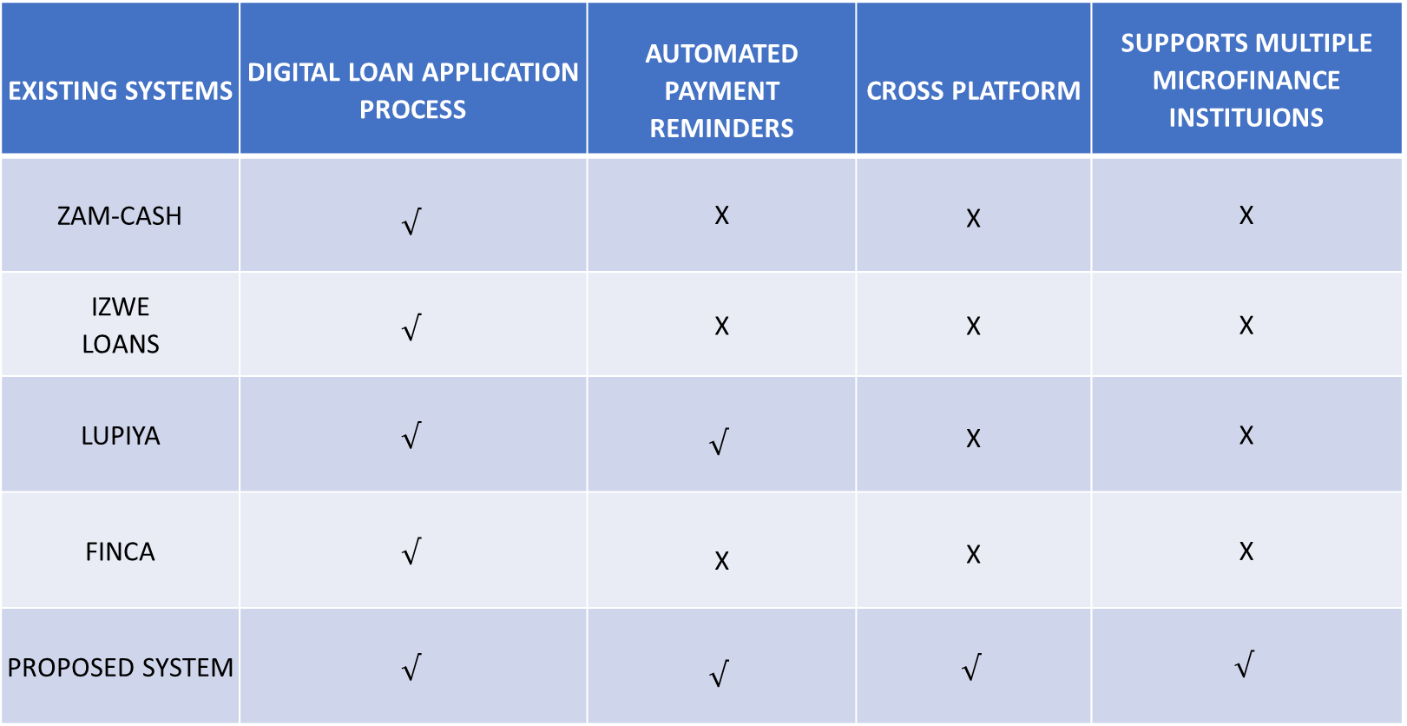
System Review
EXISTING SYSTEMS | DIGITAL LOAN APPLICATION PROCESS | AUTOMATED PAYMENT REMINDERS | CROSS PLATFORM | SUPPORTS MULTIPLE MICROFINANCE INSTITUIONS
ZAM-CASH | $$√$$ | X | X | X
IZWE LOANS | $$√$$ | X | X | X
LUPIYA | $$√$$ | $$√$$ | X | X
FINCA | $$√$$ | X | X | X
PROPOSED SYSTEM | $$√$$ | $$√$$ | $$√$$ | $$√$$

Slide 12
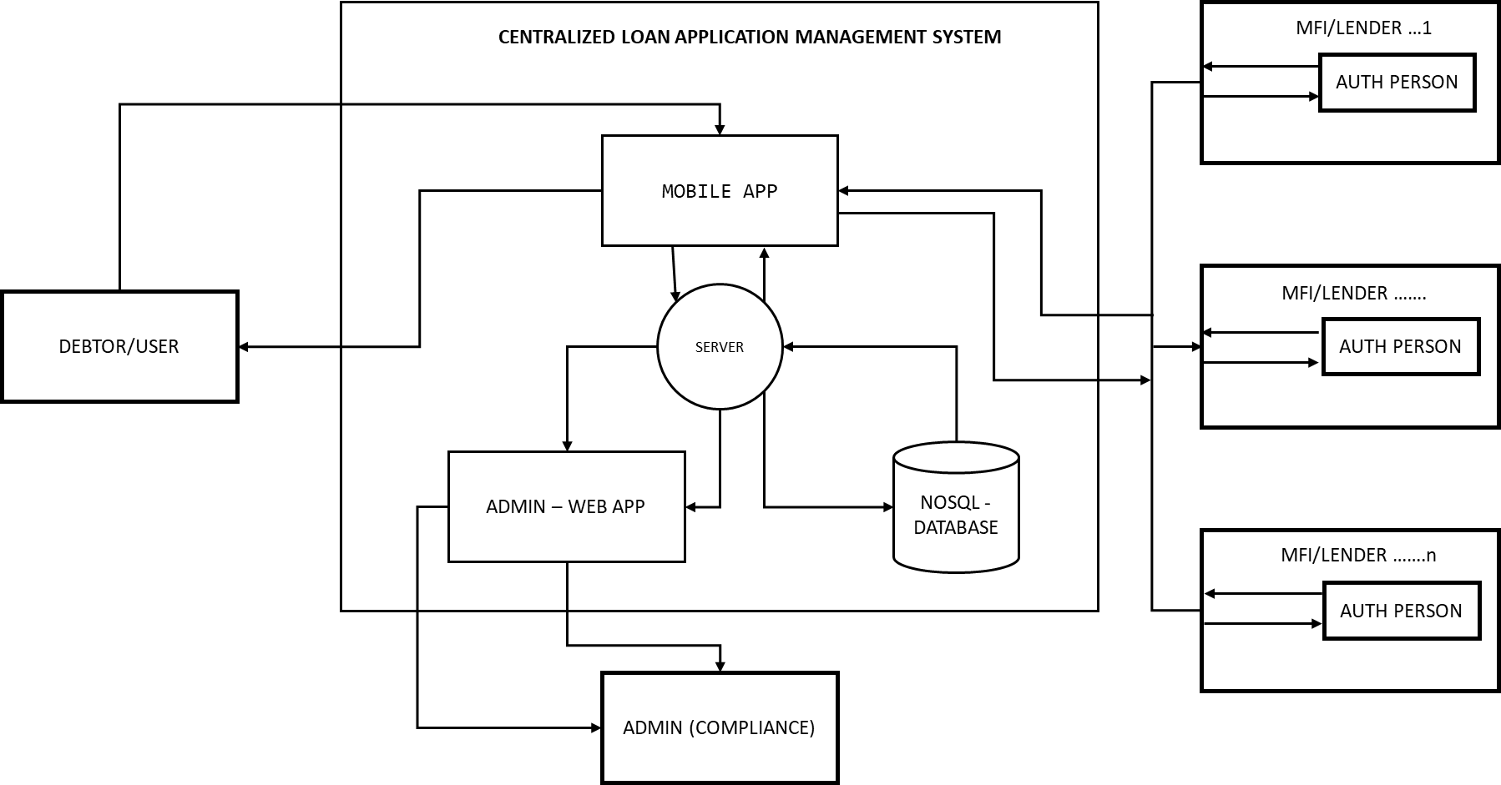
Conceptual framework

Slide 13
Research Methodology
The study adopted a descriptive research design with a quantitative approach. To collect quantitative data, online questionnaires were distributed to a diverse sample of microfinance clients. These questionnaires were structured to gather numerical and categorical data on various aspects of microfinance, such as loan applications, interest rates, credit scoring, and loan defaults.

Slide 14
Findings (Data Presentation, Analysis, & Discussions)
Statistically the research uncovered that 98.8% percent of the sampled population would value a mobile application that allows the users to find multiple Microfinance institutions on a single platform for the purpose of efficient loan interest comparison.
With regard to the need for a mobile app that digitalize the loan application process, 97.8% indicated that CLAMS would solve the challenges that surrounds the acquiring and repaying of loans.

Slide 15
Conclusion
In conclusion, this project has delved into the multifaceted realm of microfinance, focusing on the development of a Centralized Loan Application Management System (CLAMS) to address the challenges faced by microfinance institutions (MFIs) in Zambia. The study's primary objective was to create a harmonized platform that aggregates multiple MFIs, offering a centralized space for loan comparison and application. The proposed CLAMS not only streamlines the application process but also contributes to mitigating the risk of loan defaults, a pressing issue for MFIs. The research has provided insights into how such a system can be tailored to meet the needs of clients and debtors in a localized context.

Slide 16
Recommendations
As a comprehensive guide for the successful implementation and growth of CLAMS, integrating Artificial Intelligence (AI) and advanced security measures into the Centralized Loan Application Management System. By incorporating AI algorithms, the system can automate key processes such as credit scoring and risk assessment, enhancing the efficiency and accuracy of loan approvals.
Additionally, prioritize the implementation of robust security features, including encryption protocols, multi-factor authentication, and anomaly detection powered by AI, to safeguard sensitive financial data and protect against potential cyber threats.

Slide 17
THANK YOU!

